Slide 1

Basics of experimental design
Tiago Paixão
tiago.paixao@gimm.pt
Advanced Data Analysis
part of the Digital Technologies Unit

Slide 2

Outline
Why experimental design matters
Counfounders
Batch effects
Blocking
Power analysis
Gulbenkian Institute for Molecular Medicine

Slide 3
Objectives of Experimental design
Maximize biological insight
Minimize technical noise
Control for unwanted variation
e.g. Batch effects
Reduce the risk of confounding variables
Efficient use of resources
Determine optimal sample size and # of replicates
Efficient design
Statistics
Gulbenkian Institute for Molecular Medicine

Slide 4
Major pitfalls in Experimental Design
Pseudo-replication
Most common problem
Wrong experimental unit
Confounding
Treatment mixed with other factors
Batch effects
Systematic technical variation
Selection bias
Non-random exclusion of data
Insufficient power
Too few samples to detect effect
Multiple testing
Testing many outcomes without correction
Gulbenkian Institute for Molecular Medicine

Slide 5
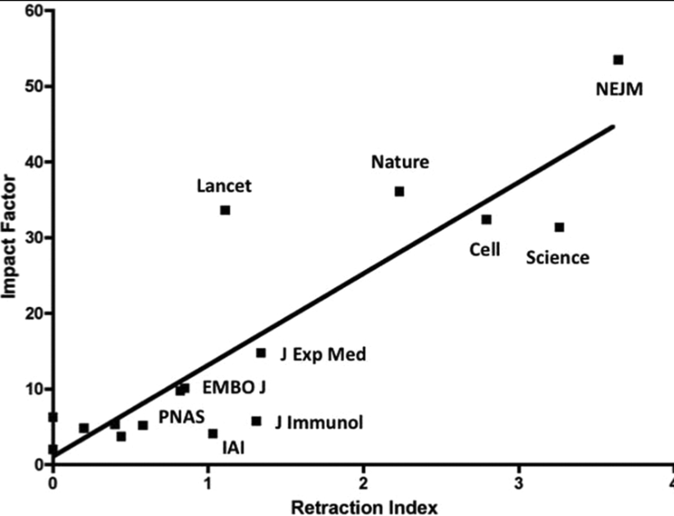
Fang, F.C., Casadevall, A., 2011. Retracted Science and the Retraction Index. Infection and Immunity. https://doi.org/10.1128/iai.05661-11
Gulbenkian Institute for Molecular Medicine

Slide 6
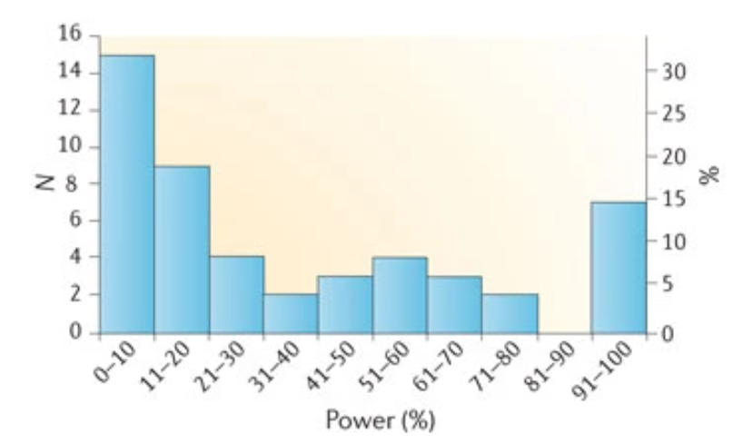
Power failure
Button, K.S., Ioannidis, J.P.A., Mokrysz, C., Nosek, B.A., Flint, J., Robinson, E.S.J., Munafò, M.R., 2013. Power failure: why small sample size undermines the reliability of neuroscience. Nat Rev Neurosci 14, 365–376. https://doi.org/10.1038/nrn3475
Gulbenkian Institute for Molecular Medicine

Slide 7
Concepts
Experimental unit
Factors, levels and interactions
Control of variance
Confounders
Power & Sample size
Blocking, Randomization and Replication
Gulbenkian Institute for Molecular Medicine

Slide 8


Experimental unit
“An experimental unit is the smallest unit of your experiment to which a treatment is independently applied.”
Cells on a petri dish
Exp unit: plate
Fish in a tank
Exp unit: tank
Mice on a cage
Exp unit: cage
Gulbenkian Institute for Molecular Medicine

Slide 9
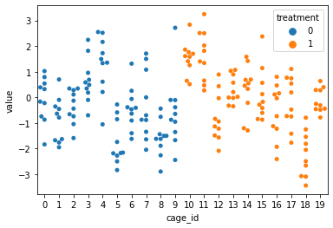
Experimental units
20 cages (some differences between them)
Each cage 10 mice
No effect of treatment
Gulbenkian Institute for Molecular Medicine

Slide 10
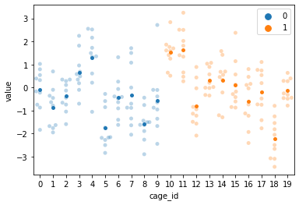
Experimental units
INCORRECT WAY
Ignore cages; use all animals as independent
CORRECT WAY:
Cage is the experimental unit
Use mean of each cage
Proportion H0 rejected: ~50%
Proportion H0 rejected: ~5%
Lots of FALSE POSITIVES

Slide 11
Experimental units
Determine the true sample size
Sample size is the # of independent experimental units (not observational units)
Pseudo replication
Affects statistical significance/power
Wrong unit typically inflate the degrees of freedom (sample size)
Affects the interpretation of results
If you unit is cages, your conclusions apply to cages
“Misidentifying the experimental unit is one of the most common and serious errors in experimental research.”
Gulbenkian Institute for Molecular Medicine

Slide 12
Confounders
“A variable that is associated with both the independent variable (e.g., treatment) and the outcome, potentially biasing the results.”
“A variable that masks the true causal relationship between the independent (treatment) and dependent (outcome) variables”
Gulbenkian Institute for Molecular Medicine

Slide 13
X
Y

Slide 14
The elemental confounds
Z
Z
Z
X
Y
X
Y
X
Y
The fork
The pipe
The collider
Gulbenkian Institute for Molecular Medicine

Slide 15
The Fork
Z
Z is a common cause to X and Y
Conditioning on Z removes correlation
X
Y
Gulbenkian Institute for Molecular Medicine

Slide 16
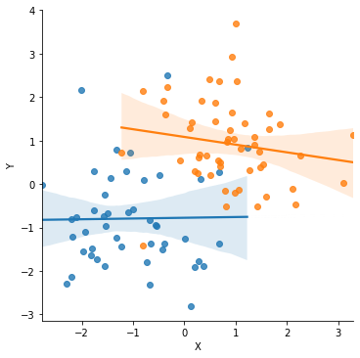
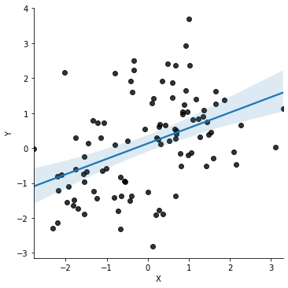
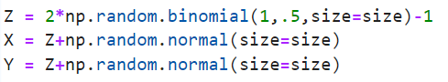
The fork
Z
X
Y
Gulbenkian Institute for Molecular Medicine

Slide 17
The Pipe
Z
X causes Z causes Y
(Z is a mediator)
Conditioning on Z removes correlation
X
Y
Data does not distinguish from the Fork!
Gulbenkian Institute for Molecular Medicine

Slide 18
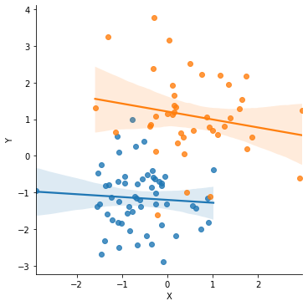
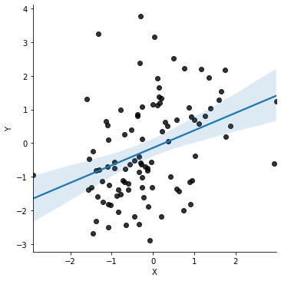
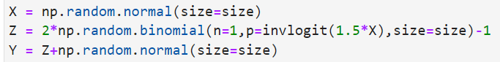
Z
X
Y
Gulbenkian Institute for Molecular Medicine

Slide 19
The Collider
Z
X and Y jointly cause Z
Conditioning on Z creates correlation
(like selecting a subpopulation)
X
Y
Gulbenkian Institute for Molecular Medicine

Slide 20
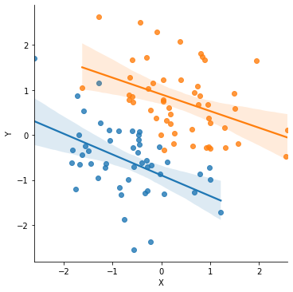
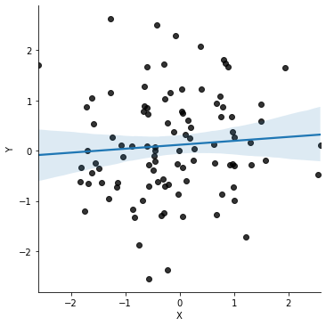
The Collider
Z
X
Y
Gulbenkian Institute for Molecular Medicine

Slide 21
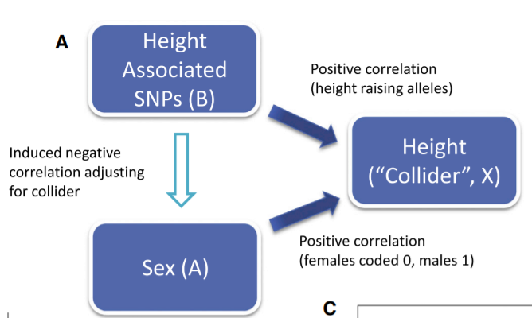
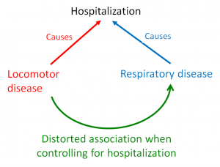
Day, 2016
https://doi.org/10.1016/j.ajhg.2015.12.019
Sacket, 1979

Slide 22
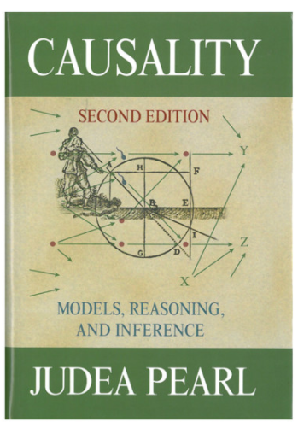
How to deal with this?
When you want to infer X -> Y:
Evaluate all paths that create non causal associations
The back door
Condition as necessary to close paths
Given that you know the causal graph!
This stuff is hard...
Gulbenkian Institute for Molecular Medicine

Slide 23
Common experimental designs
Completely Randomized Design (CRD)
• Simplest design
• Random assignment of treatments to units
Randomized Block Design (RBD)
• Group similar units into blocks
• Randomize within blocks
Factorial Designs
• Test multiple factors simultaneously
• Detect interactions
Split-plot / Nested Designs
• Factors applied at different scales
Repeated Measures / Crossover
• Subjects as their own controls
Gulbenkian Institute for Molecular Medicine

Slide 24
Randomized Block design
When to use:
Experimental units are heterogeneous
Can group units by some characteristic
Want to reduce error variance
How it works:
Group units into blocks of similar units
Each block contains at least one unit per treatment
Randomize treatments within each block
Gulbenkian Institute for Molecular Medicine

Slide 25
Blocking & Randomization
“Block what you can, randomize the rest”

Slide 26
Blocking
Group experimental units into blocks that are similar in some way (e.g., age, batch, location), then apply all treatments within each block.
Treatment
Response
Split experimental units into groups of treated/control that are identical on the blocked variable
Confound
nuissance
Sex
Age
Day of experiment
etc
Gulbenkian Institute for Molecular Medicine

Slide 27
Blocking example
Measuring effect of drug on growth on petri dishes
Experimental unit: dish
Treatment: Drug (on dish)
Response: (cell growth)
Nuissance: You can only do a few dishes per day and temperature, handling or media can change from day to day.
4 dishes per day (block)
Each block:
4 dishes, 2 treated, 2 control
10 days
Batch 1
Batch 2

Slide 28
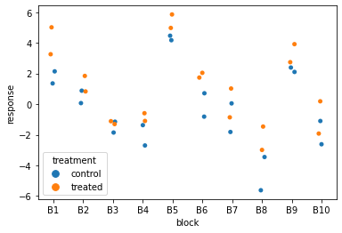
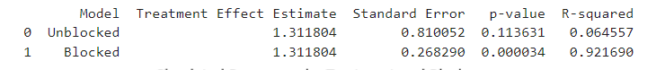
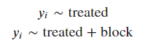
Blocking example
Batch 1
Batch 2

Slide 29
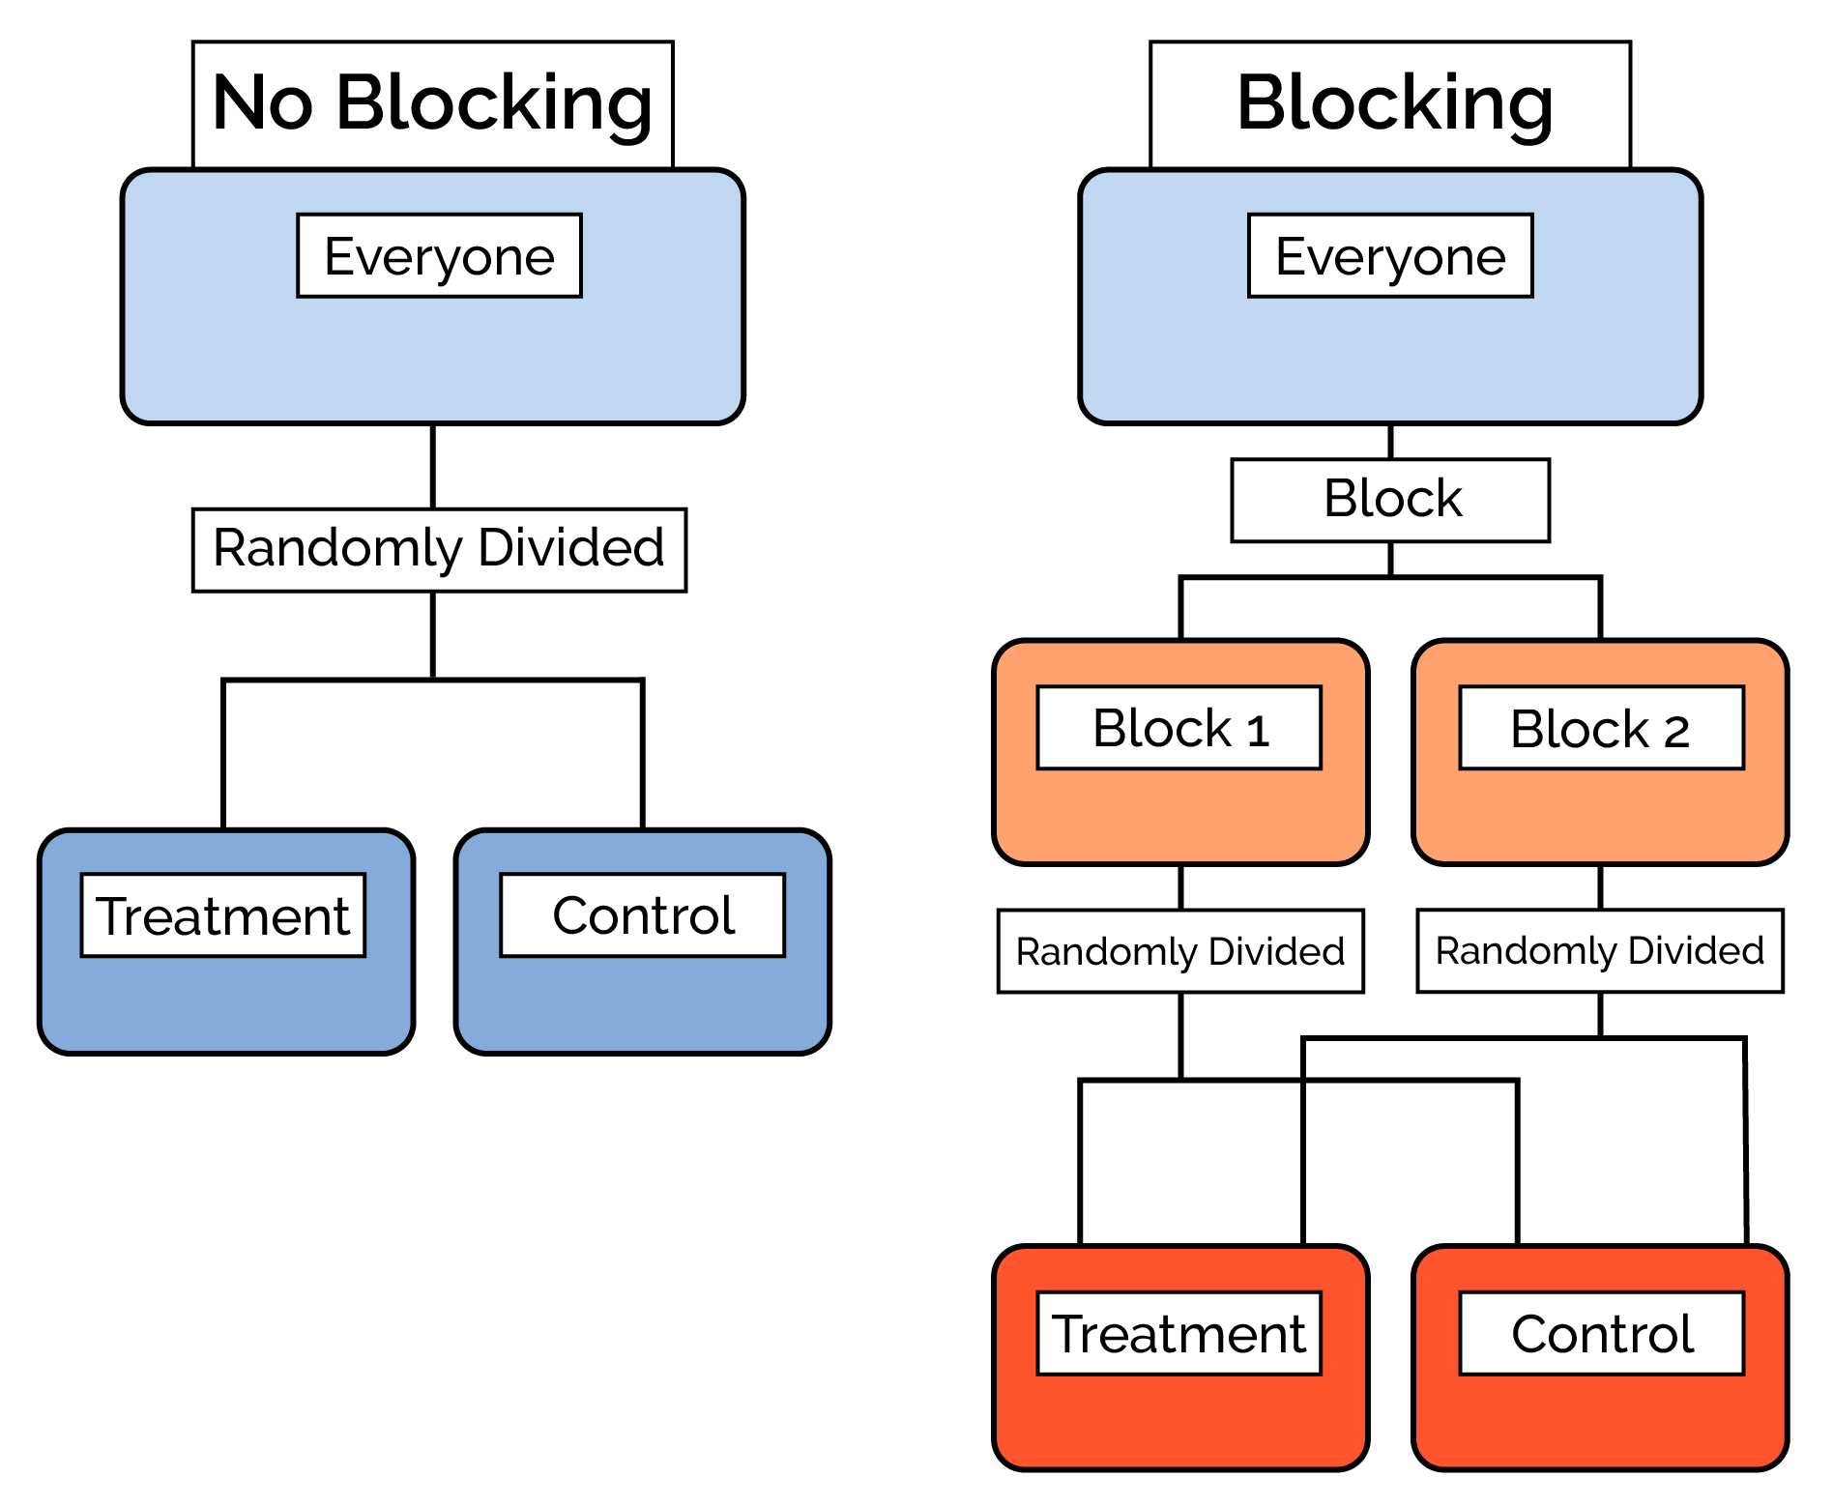
Blocking
Improves precision
Reduces risk of confounding
However:
Complexity in design
Fewer degrees of freedon
Not helpful if sources of of variation are unknown

Slide 30
Randomization
Randomization controls for:
Known and unknown confounders
Selection bias
Random assignment ensures treatment groups are comparable on average
Any differences between groups are due to chance, not bias
Gulbenkian Institute for Molecular Medicine

Slide 31
What to randomize
Treatment assignment (obviously!)
Physical positions
Plate positions in incubator
Animal cage positions on rack
Field plot locations
Order of operations
Order of sample processing
Order of measurements
Order of imaging
Technical details
Which technician does which samples
Which batch includes which samples
Which day for which treatments
Gulbenkian Institute for Molecular Medicine

Slide 32
Examples
Example 1: Incubator plate positions
• Problem: Temperature gradients in incubator
• Solution: Randomize which treatment goes in which position
Example 2: Sample processing order
• Problem: Degradation over time, technician fatigue
• Solution: Randomize order of sample processing
• Don’t process all treatment samples first, then all controls
Example 3: Animal cage positions
• Problem: Position effects (light, noise, access)
• Solution: Randomize cage positions on rack

Slide 33
Common randomization mistakes
1. Pseudo-randomization
• Alternating treatments instead of truly random
• Creates systematic patterns
2. Forgetting to randomize measurement order
• Even if treatment assignment was random
• Time-related confounding can occur
3. Not accounting for spatial gradients
• Position matters (incubators, racks, fields)
• Need to randomize or block
4. Post-hoc “randomization”
• Deciding treatment assignment after seeing the units
• Not truly random!

Slide 34
Batch effects
“Systematic non-biological variation introduced by differences in experimental conditions”
Sources:
Different days or runs of the experiment
Equipment calibration
Differences in operator/experimenter
Sample processing batches (e.g., RNA extraction, library prep)
Etc.
Can confound results, obscure true biological signals, and lead to false positives/negatives.
Gulbenkian Institute for Molecular Medicine

Slide 35
Sources of batch effects in HTSeq
Laboratory and Technical Sources
Sample Handling and Processing
Reagent Lots: Different batches of reagents (e.g., enzymes, buffers) can behave slightly differently.
Library Preparation Kits: Variability in kits or protocols used for preparing sequencing libraries.
Sequencing Machines: Differences between sequencers or even between runs on the same machine.
Flow Cell Lanes: Samples sequenced on different lanes may show systematic differences.
Operator Effects: Different technicians may introduce subtle variations in handling.
RNA/DNA Extraction Batches: Variability in extraction efficiency or purity.
Storage Conditions: Differences in temperature, duration, or freeze-thaw cycles.
Time of Processing: Samples processed on different days or times may be affected by environmental conditions.

Slide 36
Batch effects
May or may not exist
May or may not be a problem
Best Practices:
Design with batch effects in mind
Control for them statistically
not always possible
Treament
Control
Run A
Run B
Gulbenkian Institute for Molecular Medicine

Slide 37
Confounded batch effect
Treament
Simulate 1000 genes
10% DE genes
n/group = 10
Two runs
Batch effect
Control
Run A
Run B
Gulbenkian Institute for Molecular Medicine

Slide 38
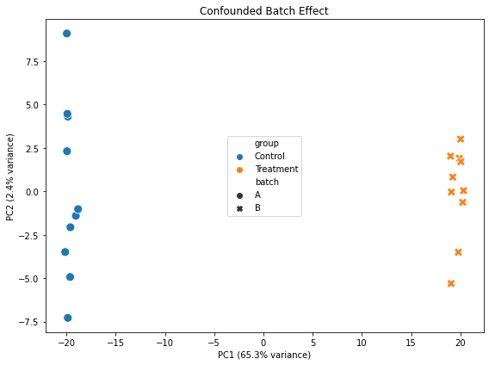
Confounded batch effect
Treament
Control
Run A
Run B

Slide 39
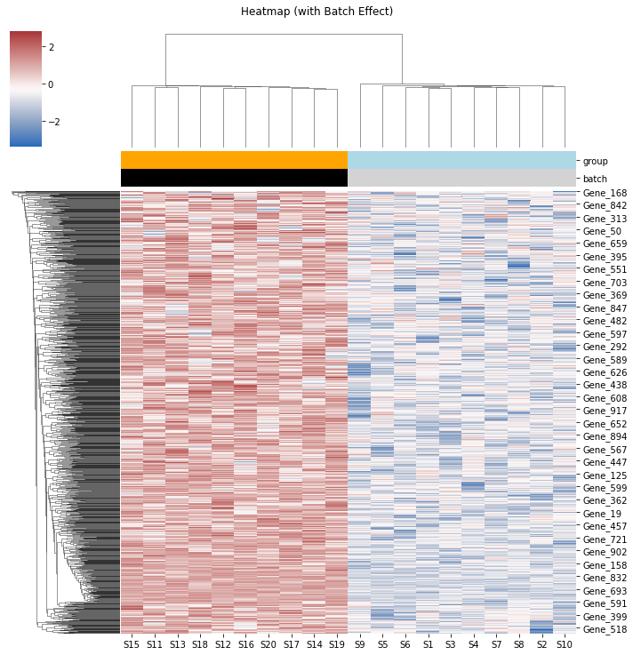
Batch “aligned” with treatment
Impossible to tell them apart
Lots of false positives
R
T
G

Slide 40
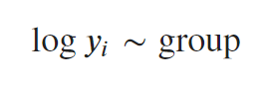
Batch “aligned” with treatment
Impossible to tell them apart
Lots of false positives
DE genes: 99.9%
False Positives: 89.9%

Slide 41
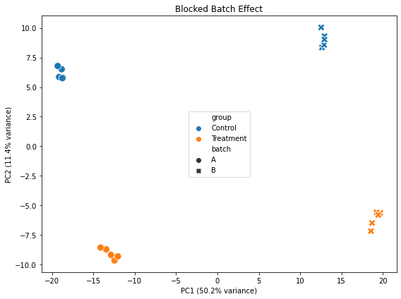
Batch effect
Treament
Control
Run A
Run B

Slide 42
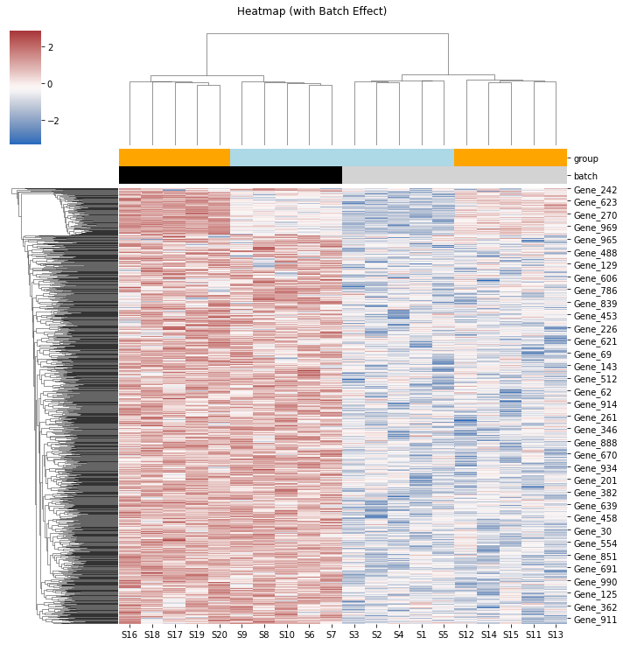
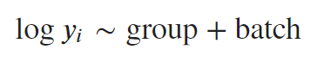
Confounded
But “fixable”
DE genes: 12%
False Positives: 2%

Slide 43
How to correct?
Regression
Include batch as a covariate
More elaborate strategies
Random effects on batch, s
Useful packages:
comBat / comBat-seq / pyComBat (now: inMoose)
SVA

Slide 44
Confounds & Batch effects
Confounds can distort the measured correlation
Be careful about what you control for
Batch effects are common (and often large) confounds
Blocking helps control batch effects
Clear, expected sources of variability
Ensure reliable and reproducible science

Slide 45
Power analysis
Determining sample sizes

Slide 46
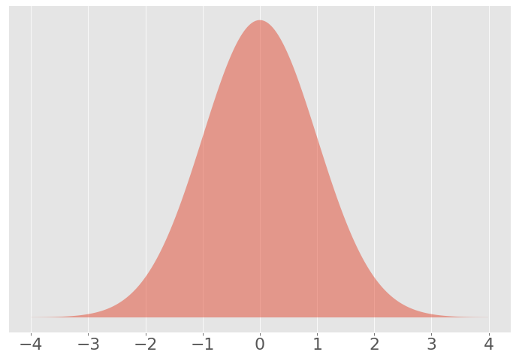
Null hypothesis
Statement about the system that you are trying to disprove
Specified in terms of a statistical model, a sampling distribution against which you can compare your data
Usually, a statement of “no effect” or “no relationship”
Needs to be reasonable! Give your null hypothesis a chance.
Gulbenkian Institute for Molecular Medicine

Slide 47
p-values
A p-value is the probability of the data, given that the null hypothesis is true.
Formally: “the probability of observing a test statistic as large or larger as your data, under the null hypothesis”.
Strength of evidence against the null hypothesis
pvalue
Gulbenkian Institute for Molecular Medicine

Slide 48
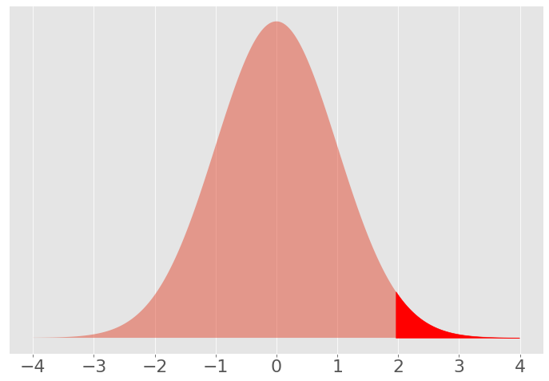
Significance level (α)
The (pre-specified) critical value for the p-value that we consider “enough evidence” to reject the null hypothesis
Probability of rejecting the null hypothesis when it is true (when there is no effect) – type I error
pvalue
Gulbenkian Institute for Molecular Medicine

Slide 49
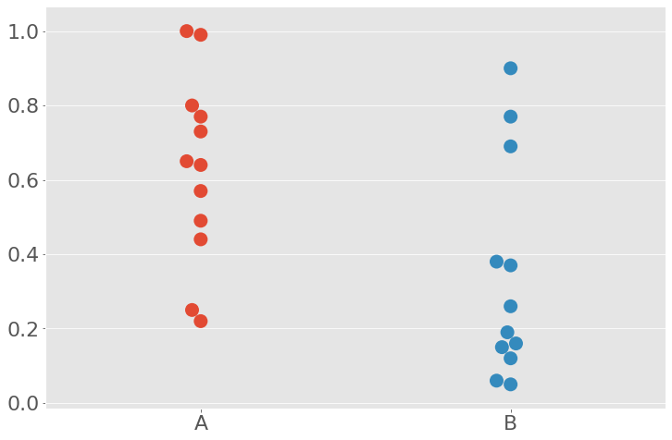
Another instructive example
You have samples from 2 populations
Are they different?
A | B
0.95 | 0.81
0.02 | 0.73
0.73 | 0.11
0.39 | 0.56
0.93 | 0.75
0.59 | 0.49
0.58 | 0.09
Gulbenkian Institute for Molecular Medicine

Slide 50
Another instructive example
Null hypothesis: no difference between the groups
If there is no difference, the label A or B doesn’t matter!
A | B
0.95 | 0.81
0.02 | 0.73
0.73 | 0.11
0.39 | 0.56
0.93 | 0.75
0.59 | 0.49
0.58 | 0.09
Gulbenkian Institute for Molecular Medicine

Slide 51
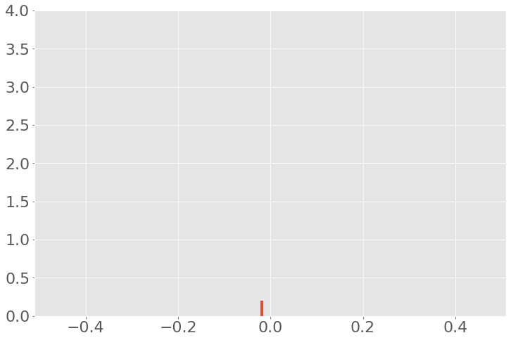
Another instructive example
Null hypothesis: no difference between the groups
If there is no difference, the label A or B doesn’t matter!
A | B
0.95 | 0.81
0.02 | 0.73
0.73 | 0.11
0.39 | 0.56
0.93 | 0.75
0.59 | 0.49
0.58 | 0.09
Gulbenkian Institute for Molecular Medicine

Slide 52
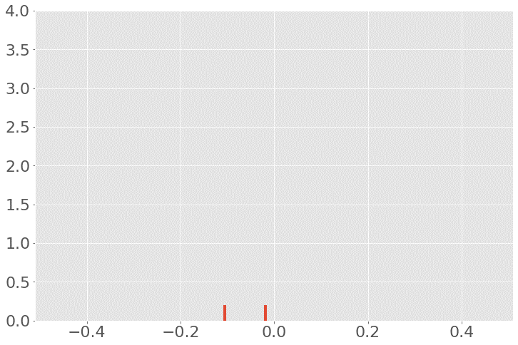
Another instructive example
Null hypothesis: no difference between the groups
If there is no difference, the label A or B doesn’t matter!
A | B
0.95 | 0.81
0.02 | 0.73
0.73 | 0.11
0.39 | 0.56
0.93 | 0.75
0.59 | 0.49
0.58 | 0.09
Gulbenkian Institute for Molecular Medicine

Slide 53
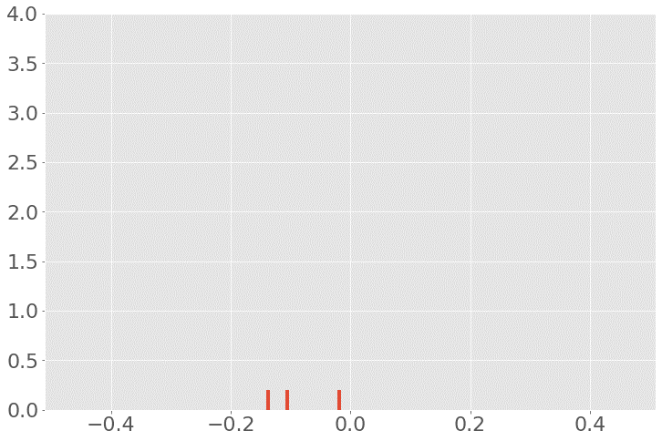
Another instructive example
Null hypothesis: no difference between the groups
If there is no difference, the label A or B doesn’t matter!
A | B
0.95 | 0.81
0.02 | 0.73
0.73 | 0.11
0.39 | 0.56
0.93 | 0.75
0.59 | 0.49
0.58 | 0.09
Gulbenkian Institute for Molecular Medicine

Slide 54
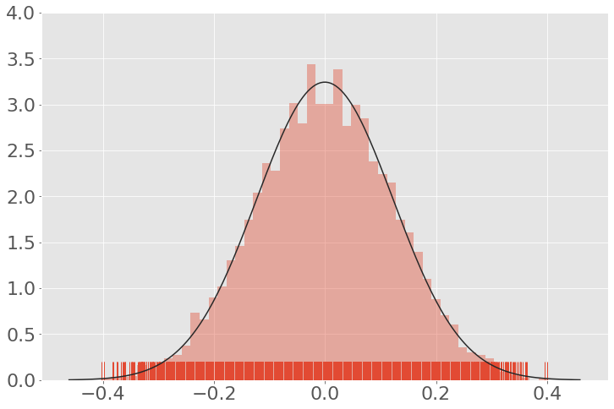
Another instructive example
Null hypothesis: no difference between the groups
If there is no difference, the label A or B doesn’t matter!
A | B
0.95 | 0.81
0.02 | 0.73
0.73 | 0.11
0.39 | 0.56
0.93 | 0.75
0.59 | 0.49
0.58 | 0.09
Gulbenkian Institute for Molecular Medicine

Slide 55

Another instructive example
Null hypothesis: no difference between the groups
Compare with the value from our data.
A | B
0.95 | 0.81
0.02 | 0.73
0.73 | 0.11
0.39 | 0.56
0.93 | 0.75
0.59 | 0.49
0.58 | 0.09
Gulbenkian Institute for Molecular Medicine

Slide 56
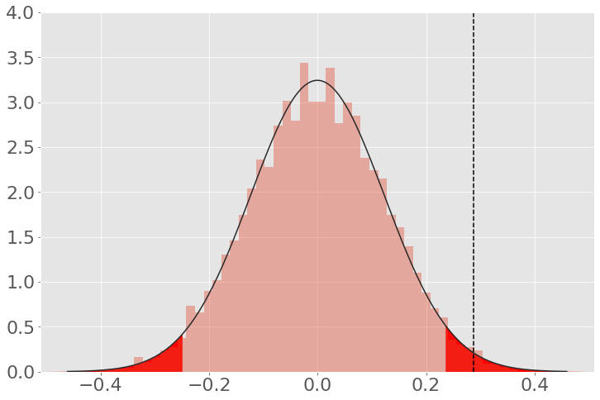
Another instructive example
Null hypothesis: no difference between the groups
Compare with the value from our data.
A | B
0.95 | 0.81
0.02 | 0.73
0.73 | 0.11
0.39 | 0.56
0.93 | 0.75
0.59 | 0.49
0.58 | 0.09
Gulbenkian Institute for Molecular Medicine

Slide 57
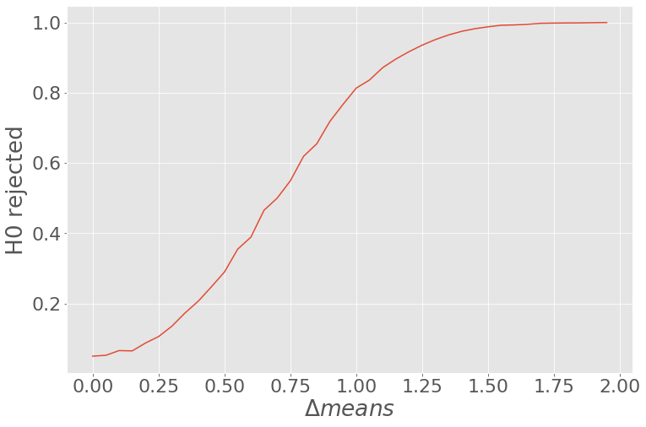
Type II errors
Significance level (α) determines the Type I error
“I accept a certain level of false rejections of the H₀”
We choose this!
What about when there is in fact an effect?
We also would like to detect when there is an effect!
The probability that we reject the H0 when there is an effect is the power of the test
The power of a test, depends on:
Effect size
Significance level
Sample size
Gulbenkian Institute for Molecular Medicine

Slide 58
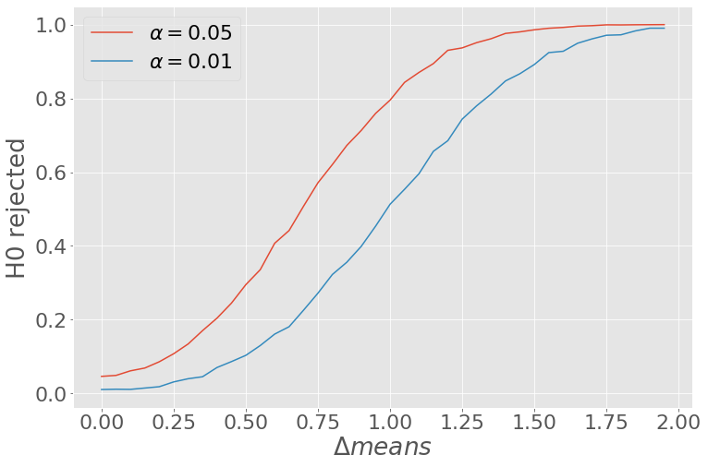
Effect of significance level
Significance level (α) determines the Type I error
But also affects the power of the test
 |  | Statistical test
 |  | No effect H0 accepted | Effect H0 rejected
Truth | No Effect | True Negative | False Positive (Type I: α)
 | Effect | False Negative (Type II: β) | True Positive

Slide 59
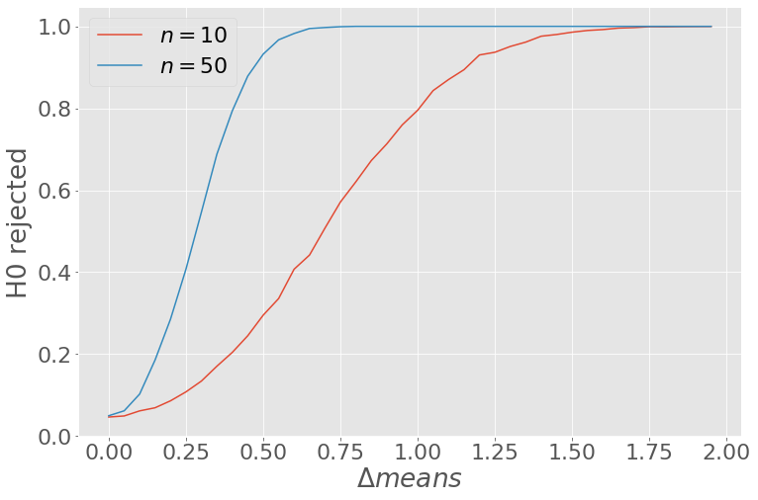
Effect of sample size
Usually, larger sample sizes lead to increased power
Statistical significance does not mean biological significance!
Gulbenkian Institute for Molecular Medicine

Slide 60
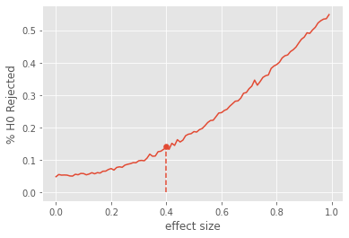
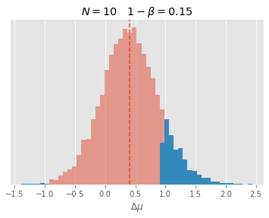
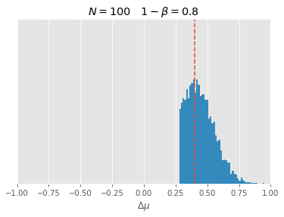
Low-powered studies
Low chance of detecting an effect (even if there is one)
BUT, if you do detect an effect, its size will be overestimated
Gulbenkian Institute for Molecular Medicine

Slide 61
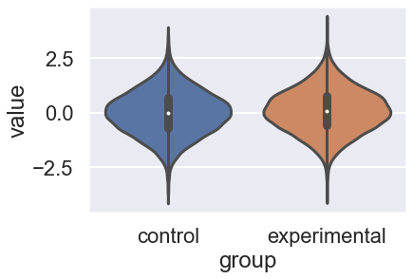
Low p-values do not mean larger effect sizes
p=8.3 x 10⁻¹²
p-value is the probability of the statistic under the null hypothesis
effect size is difference between the null and the alternative.
∆μ = 0.1
Minimum effect size at 90% power: 0.045
Gulbenkian Institute for Molecular Medicine

Slide 62
Conclusions
Know your experimental unit
Reduce false positives
Blocking and factorial designs improve efficiency
Blocking controls known sources of variability
Factorial designs test multiple variables simultaneously
Low-powered studies increase false positives
And are a waste of money
Statistical significance is NOT biological significance

Slide 63

Thank you!
tiago.paixao@gimm.pt
ada@gimm.pt

Slide 64
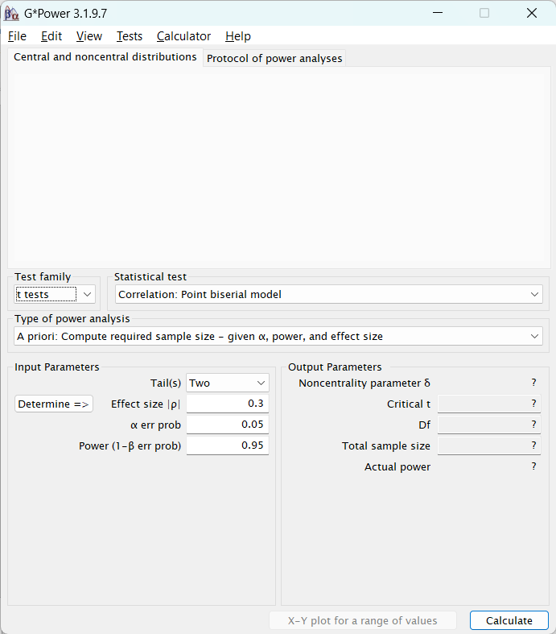
G*Power
Test to use
Type of power analysis:
Typically a priori
Hypothesis test Parameters:
Tails:
Typically two
Effect size:
The hardest part
α (type I error):
typically 5%
Power (1-β):
between 80%-95%

Slide 65
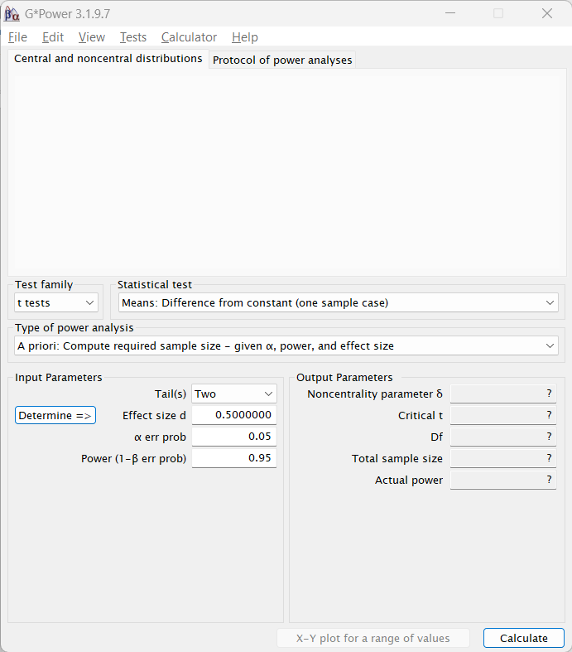
Effect sizes
A standardized measure of the difference
Determine the minimum effect you’d like to detect reliably
Aim for biologically relevance
Make you choices and live with the consequences
Gulbenkian Institute for Molecular Medicine

Slide 66
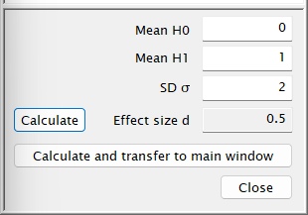
Effect sizes – t-test one sample
T-test one sample
H0: the mean you want to compare against
H1: the mean of the sample you’d like to detect
SD: the standard deviation you expect
Gulbenkian Institute for Molecular Medicine

Slide 67
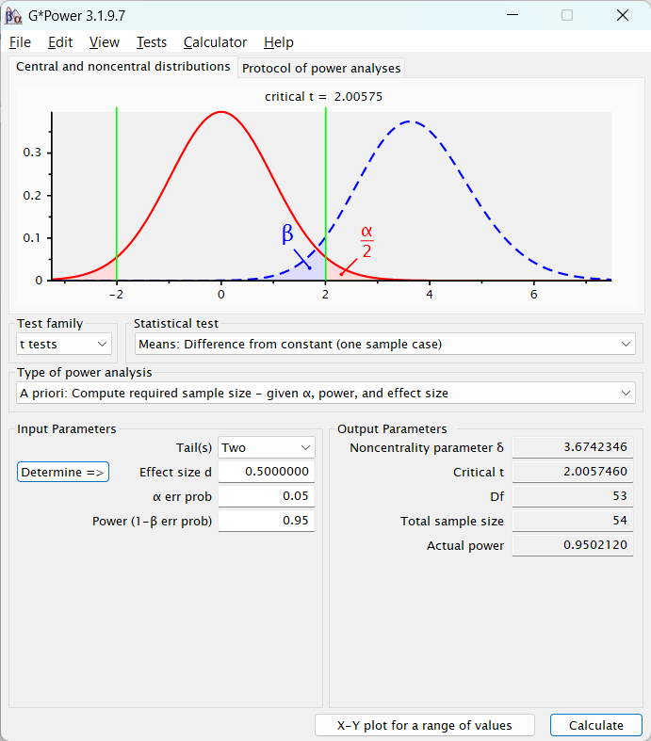
Effect sizes – t-test one sample
Cohen’s d:
difference in means over standard deviation
Sample size: 54
Gulbenkian Institute for Molecular Medicine

Slide 68
But how do you calculate effect size, really?

Slide 69
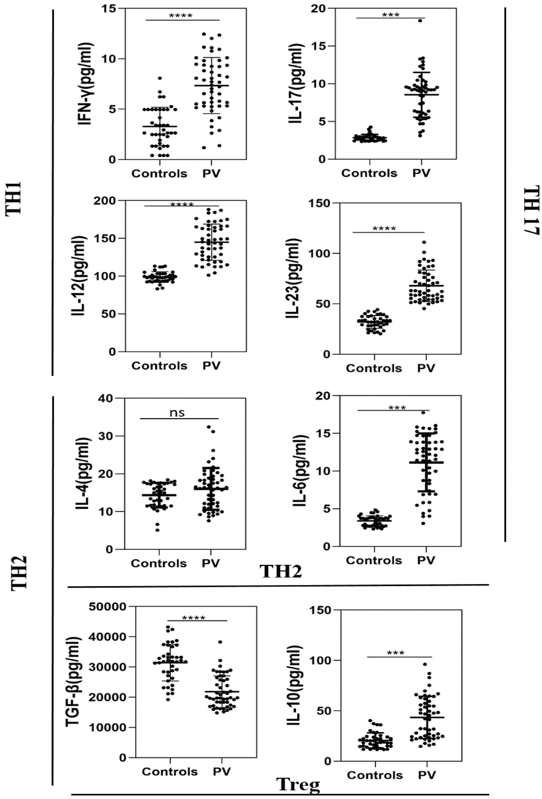
But how do you calculate effect size, really?
Resort to prior knowledge!
Use the literature!
Think about what a biologically relevant difference actually is!
Singh P K, Das S, Rai G, et al A Snapshot of T Cell Subset Cytokines in Pemphigus Vulgaris: A Cross-Sectional Study. Cureus 14(10): e29890. doi:10.7759/cureus.29890
Gulbenkian Institute for Molecular Medicine

Slide 70
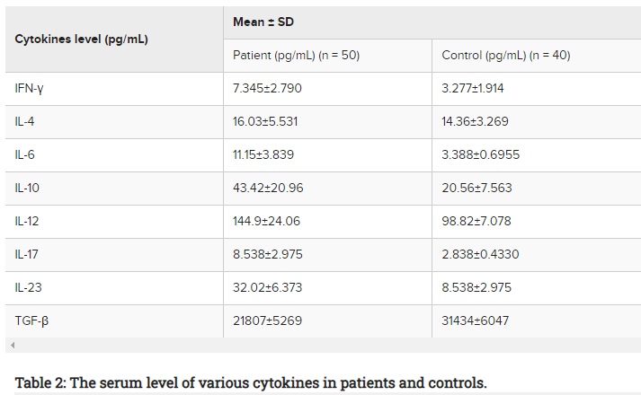
Check the literature
Singh P K, Das S, Rai G, et al A Snapshot of T Cell Subset Cytokines in Pemphigus Vulgaris: A Cross-Sectional Study. Cureus 14(10): e29890. doi:10.7759/cureus.29890
Gulbenkian Institute for Molecular Medicine

Slide 71
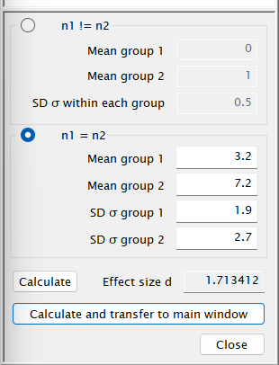
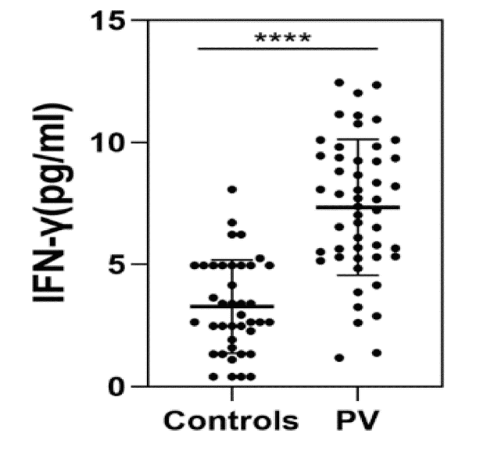
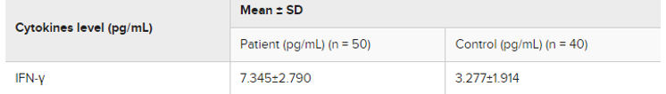
G*Power examples
Test for diferences in IFNg:
We decide to use t-test (previous data seems normal)
Set significance level and power desired
Find the mean and sd of “control”
Decide on a minimum (biologically relevant) effect you’d like to detect
Calculate sample size
Gulbenkian Institute for Molecular Medicine

Slide 72
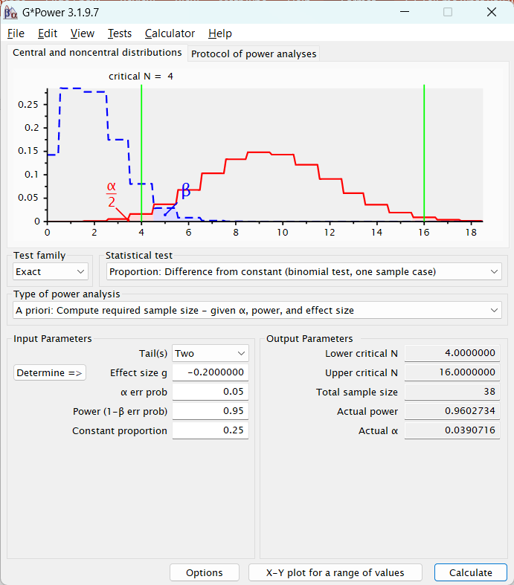
G*Power examples
Imagine that a researcher wants to study a hybrid mouse in which one of the copies of a gene (gem) is replaced by a non-functional protein (gfp). However, when the hybrids were crossed, out of 10 pups no homozygous gem genotypes appeared.
What is the sample size we would need to test if pem transmits in a non-Mendelian way (p≠1/4)
Gulbenkian Institute for Molecular Medicine

